Slide 1


Implementation of Chatbot using NLP
Student Name: KUNATI KAVITHA
AICTE Student ID: STU6744ab571ded31732553559

Slide 2

Learning Objectives
Understand the basics of Natural Language Processing (NLP) and its role in chatbot development.
Learn how to apply tokenization and vectorization (TF-IDF) for text processing.
Implement logistic regression for chatbot response classification.
Gain hands-on experience with Python, using Jupyter Notebook and VS Code
for development.
Deploy a chatbot using Streamlit for an interactive user experience.
Implement a conversation log to track and analyze chatbot interactions.
Explore the integration of NLP and machine learning to improve chatbot accuracy and performance.
GOAL
Source : www.freepik.com/

Slide 3
Tools and Technology used
Development and IDEs:
Jupyter Notebook,VS Code
Programming Language:
Python
Libraries :
NLTK: For natural language processing tasks like tokenization
Streamlit: For creating an interactive web-based UI
JSON: For storing intents and responses
TF-IDF Vectorizer: For converting text into numerical representations
Scikit-learn: For machine learning models and TF-IDF vectorization
Logistic Regression: For intent classification and some more
Deployment: Github

Slide 4
Methodology
Data Preprocessing:
Collected and cleaned text data for chatbot training. Applied tokenization to break text into smaller units.
Text Representation:
Used TF-IDF vectorization to convert text into numerical formation for
Model Training:
Implemented logistic regression for chatbot response classification. Trained the model on preprocessed data to improve accuracy.
Custom Function Development:
processing.
Created a custom response function to generate chatbot replies based on user input.
Frontend Development:
Integrated the chatbot with Streamlit for an interactive and user-friendly interface.
Conversation Logging:
Implemented a conversation log to store and track chatbot interactions for analysis.
Testing & Deployment:
Tested chatbot performance with different queries. Deployed the chatbot for real-time user interactions.

Slide 5
Problem Statement:
Many chatbots struggle with understanding human language, leading to inaccurate or irrelevant responses. The primary challenge lies in processing and interpreting natural language effectively. To address this, we use Natural Language Processing (NLP) techniques, including tokenization and vectorization, to break down input text into structured data. By leveraging machine learning models, we aim to enhance chatbot accuracy, ensuring more relevant and human-like responses, ultimately improving user interaction and experience.

Slide 6
Solution:
To enhance chatbot accuracy and human language understanding, we implemented Natural Language Processing (NLP) techniques. The process began with tokenization, where input text was broken down into smaller meaningful units. Next, we applied vectorization using TF-IDF (or other vectorization techniques), converting the textual data into a numerical format that machine learning models can process.
For classification, we trained a logistic regression model, enabling the chatbot to analyze and predict responses effectively. Additionally, a custom function was created to generate accurate and context-aware responses based on user input.
Finally, we integrated the chatbot with an interactive Streamlit frontend, providing users with a seamless and engaging experience. This approach ensures that the chatbot understands user queries better and delivers more relevant, human-like responses.

Slide 7
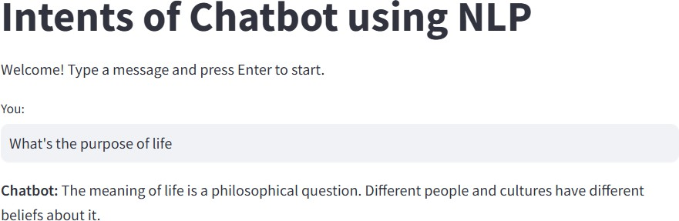
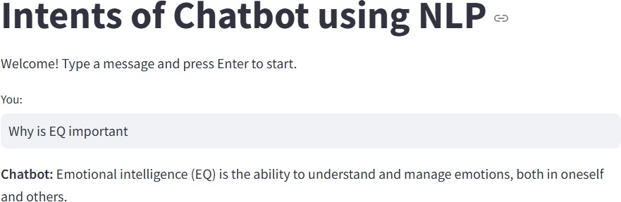
Screenshot of Output:

Slide 8
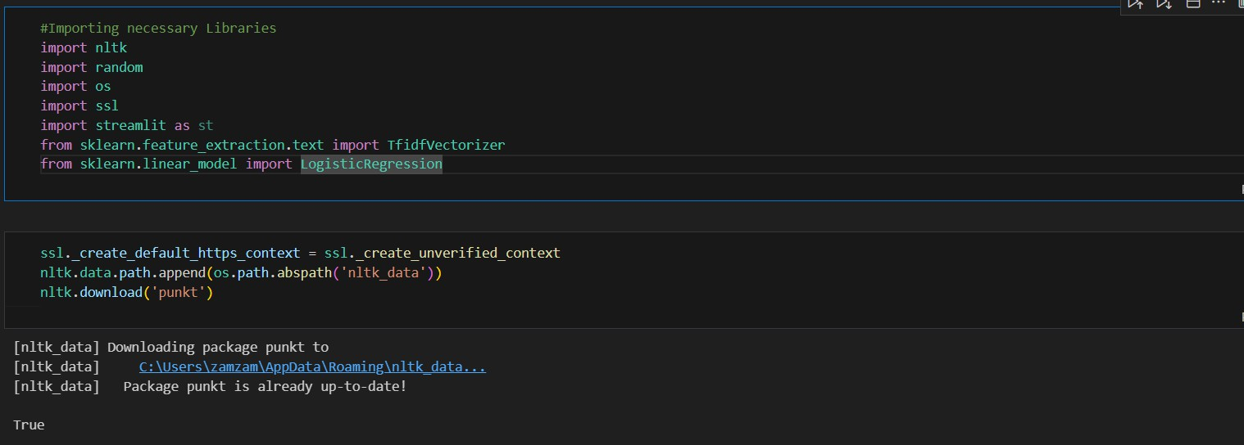
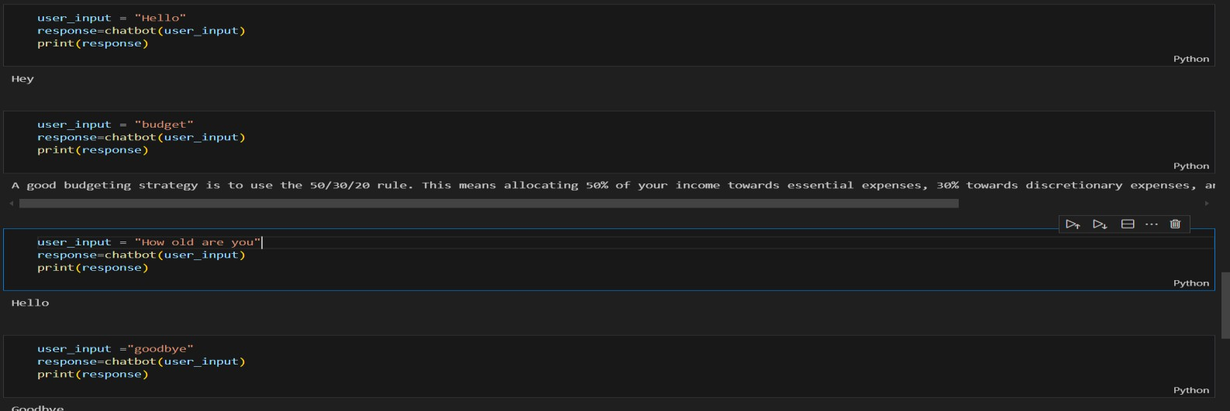

Slide 9
Conclusion:
We successfully developed a chatbot using basic NLP techniques with Python as the programming language. The implementation was done using Jupyter Notebook and Visual Studio Code, while Streamlit was used to create an interactive web-based interface.
Additionally, we incorporated a conversation log to store chatbot interactions, allowing for future reference and analysis. This project demonstrates how NLP, machine learning models, and deployment tools can be combined to build an intelligent chatbot capable of understanding and responding to human queries effectively.
Github Repository link:https://github.com/Hemasree71/Chatbot_using_NLP_AICTE_Cycle4.git

